Slide 1


Problem Statement: Unilever Data Science POC Use Case
Team Name: algo_souls
Team Members: Amit Divekar (Github ID: amitdivekar30)
Bhushan Mahajan (Github ID: BhushanDA)
Language Used: R Programming

Slide 2
Problem Statement
What are the major drivers for sales(EQ)?
Knowing the drivers, how accurately we can predict future sales for next 6 periods?

Slide 3
Flow of Presentation
Data Preprocessing
Driver Selection
Sales Forecast for next 6 periods
Summary

Slide 4
1. Data Preprocessing
Datasets: Training and Test
Training Dataset is day wise while Test Dataset is Period wise
1 Period = 4 Weeks = 28 days
Period calculation: average of drivers for 28 days

Slide 5
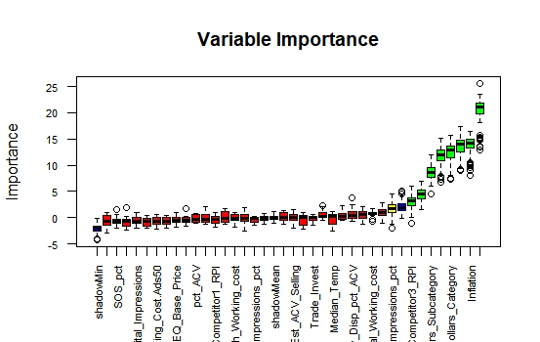
2. Driver Selection
Boruta Algorithm

Slide 6
2. Driver Selection(cont..)
b) Random forest
Driver | Value
Median_Rainfall | 1933328.6
Social_Search_Impressions | 1416648.1
pct_PromoMarketDollars_Category | 1238825.3
Inflation | 1221834.4
EQ_Category | 883881.5
pct_PromoMarketDollars_Subcategory | 861243.2

Slide 7
2. Driver Selection(cont..)
From Boruta algorithm and Random Forest, following significant drivers are selected:
Social_Search_Impressions
Median_Rainfall
Inflation
pct_PromoMarketDollars_Category
EQ_Category
pct_PromoMarketDollars_Subcategory
EQ_Subcategory

Slide 8
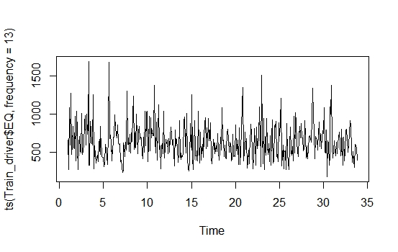
3. Sales Forecast
Trend of EQ for Training +Test Dataset

Slide 9
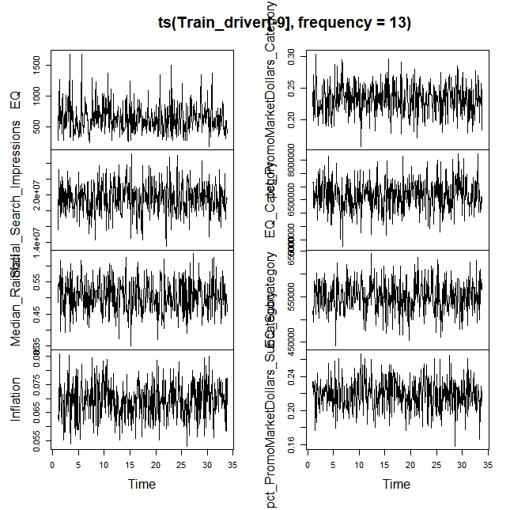
3. Sales Forecast(contd..)
Trend of all Drivers for Training + Test Dataset

Slide 10
3. Sales Forecast(contd..)
Model Bulding:
Algorithm used: VAR (Vector Autoregression)
MAPE= 43.64
Lag selected=3
Model name for forecast= final_model

Slide 11
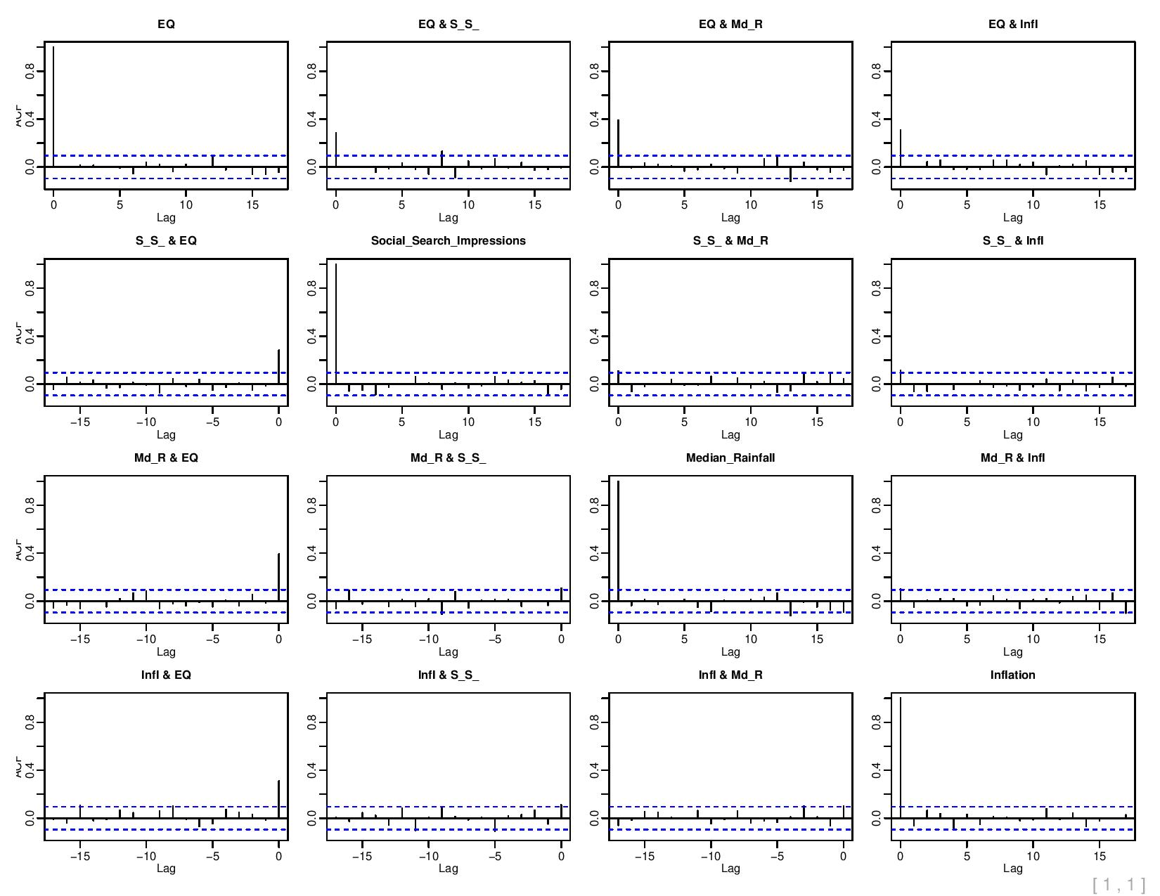
3. Sales Forecast(contd..)
ACF plot

Slide 12
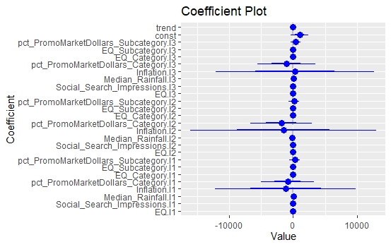
3. Sales Forecast(contd..)
Coefficint plot

Slide 13
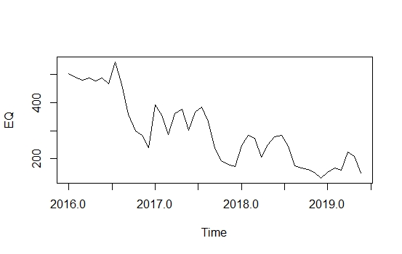
3. Sales Forecast(contd..)
Forecast for next 6 periods:
Period | EQ Forecast(Sales)
2019 Period 1 | 152.2461
2019 Period 2 | 168.6202
2019 Period 3 | 159.5517
2019 Period 4 | 223.2789
2019 Period 5 | 209.7621
2019 Period 6 | 148.7960
Forecast

Slide 14
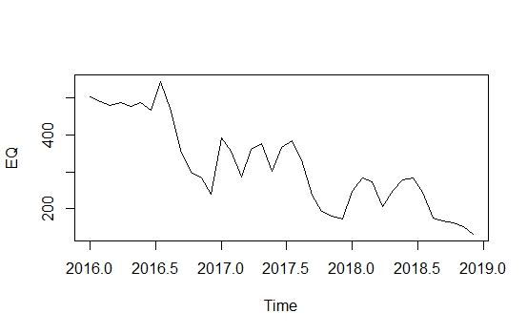
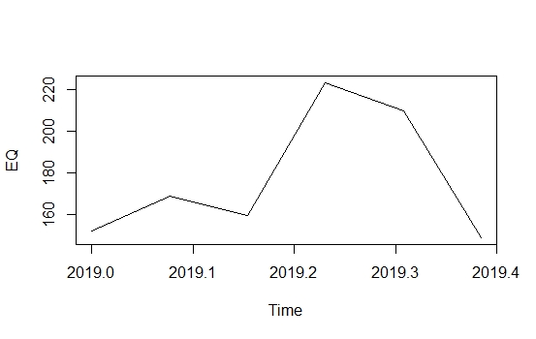
3. Sales Forecast(contd..)
Forecast for next 6 periods:
Test Data Trend
Forecast Trend

Slide 15
4. Summary
After importing data, Training data is converted into periodic with 428 periods.
Drivers are selected using Boruta and Randomforest.
Using Multivariate forecasting sales(EQ) is predicted.
From forecast it is observed that there is downward trend for sales.

Slide 16
Thank You!!!

